Slide 1
Distributed Deep Learning
Bethany Lusch
Argonne National Laboratory
Building on content from Sam Foreman, Khalid Hossain, Väinö Hatanpää, Shilpika, and Nathan Nichols

Slide 2
Why Distributed Training?
Can’t fit problem on one GPU (e.g. model too big for memory)
Or could iteratively load data into memory, but too slow

Slide 3
Distributed DL for Science
“NeuroMamba: A State-Space Foundation Model for Functional MRI” (2025) – 32 nodes on Aurora
“MProt-DPO: Breaking the ExaFLOPS Barrier for Multimodal Protein Design Workflows with Direct Preference Optimization” (2024) – 3200 nodes on Aurora
“AERIS: Argonne Earth Systems Model for Reliable and Skillful Predictions” (2025) - 10k nodes on Aurora

Slide 4
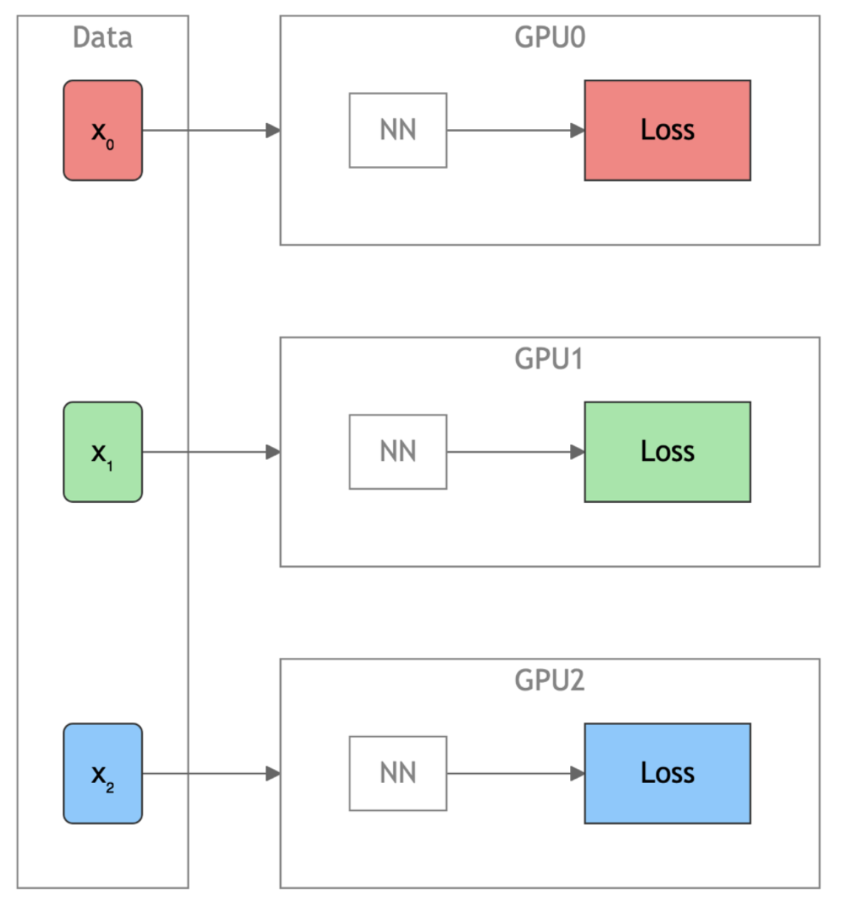
Training on Multiple GPUs with Data Parallelism
Figure by Sam Foreman

Slide 5
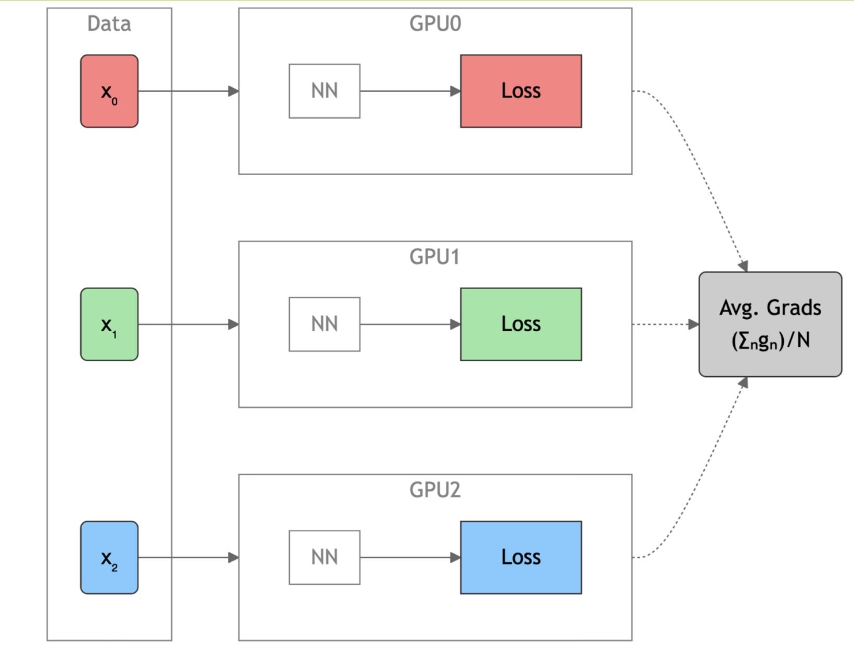
Data Parallel: Forward Pass
Figure by Sam Foreman
Notes:
Stop – why does averaging gradients work here?

Slide 6
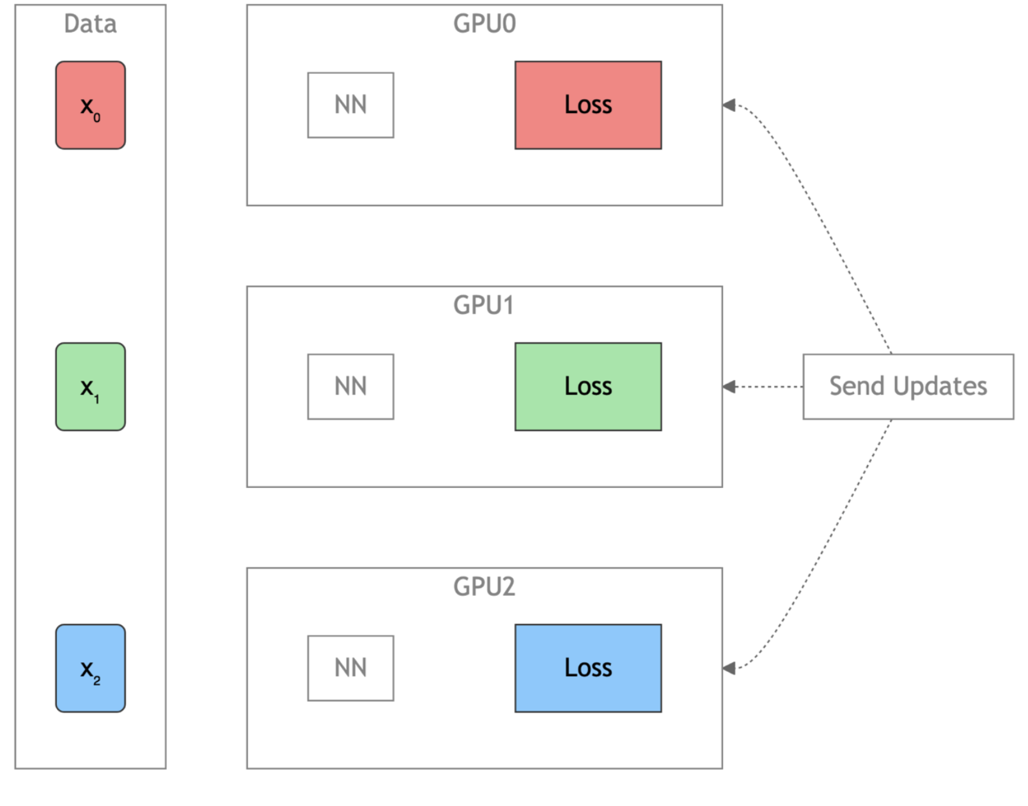
Data Parallel: Backward Pass
Figure by Sam Foreman

Slide 7
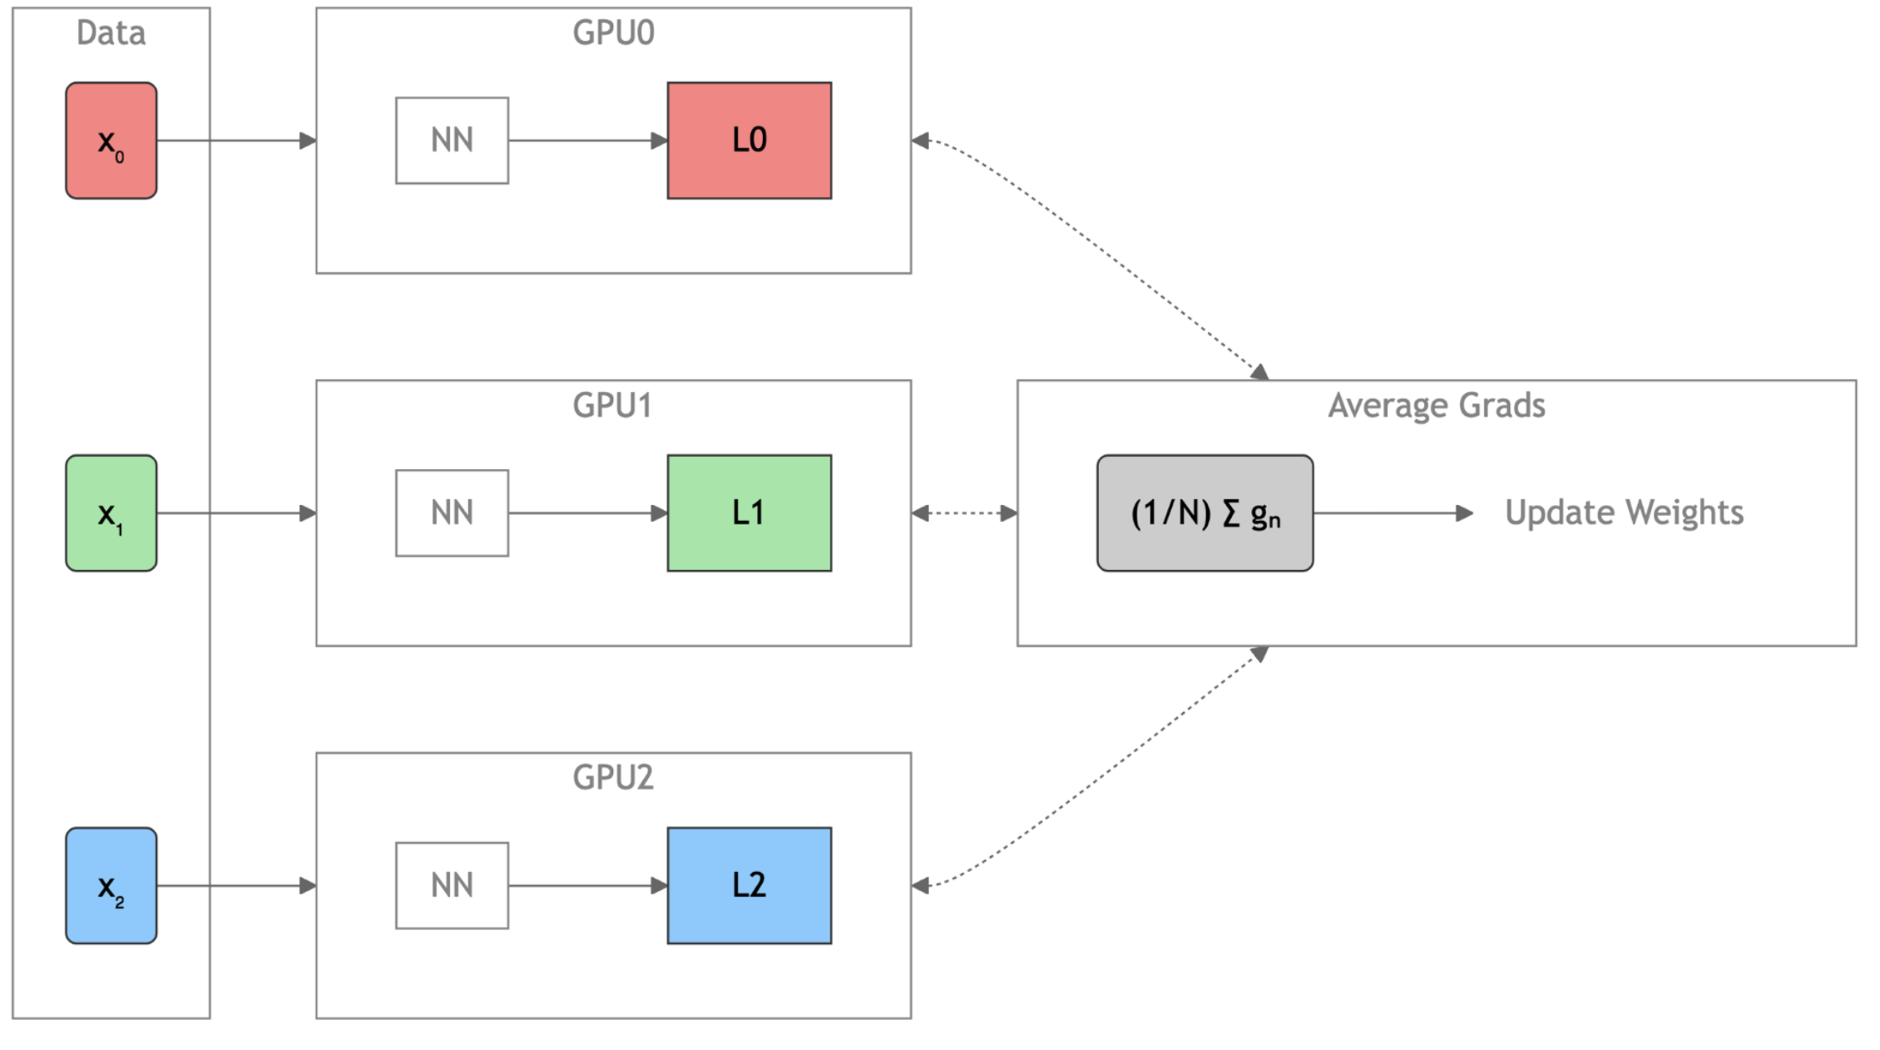
Data Parallel: Full Setup
Figure by Sam Foreman

Slide 8
Data Parallel Communication
Single-GPU training
Data-parallel communication
Setup
Create dataset and dataloader
Create model, optimizer, loss criterion
Move model and loss criterion to GPU
For each epoch:
  For each batch:
    Move batch to GPU
    Apply the model (forward pass)
    Calculate the loss
    Update the gradients (backward pass)
    Move optimizer to next step
Initialize communicator (process group)
Each rank has unique data (partition or sample) – could involve scatter
Broadcast state so all ranks start with same model, parameters, etc.
Allreduce gradients (overlap with backward pass)
Clean up process group
How do we translate the diagrams to set of collectives?
Abstracting PyTorch DDP. Details: https://docs.pytorch.org/docs/2.13/notes/ddp.html

Slide 9
Data Parallel Code Changes
Single-GPU training
Data-parallel training code changes
Setup
Create dataset and dataloader
Create model, optimizer, loss criterion
Move model and loss criterion to GPU
For each epoch:
  For each batch:
    Move batch to GPU
    Apply the model (forward pass)
    Calculate the loss
    Update the gradients (backward pass)
    Move optimizer to next step
Additional local setup
Initialize communicator (process group)
Pin local rank to GPU
Partition data over GPUs (e.g. sampler)
Scale learning rate by # of ranks*
Set up model for data parallel
Tell sampler which epoch
Clean up process group
Abstracting PyTorch DDP. Details: https://docs.alcf.anl.gov/aurora/data-science/frameworks/pytorch
* Sam Foreman will explain this in the afternoon

Slide 10
Data Parallel Summary
Replicate full model on each worker
Each rank processes unique mini-batch shard
Gradients all-reduced after backward pass
Simple; scales to 10k+ GPUs
Bandwidth-bound at very large scale

Slide 11
Communication Libraries
MPI: portable, mature; rich semantics; CPU-centric; scales well
Vendor-specific *CCLs:
  NCCL: NVIDIA GPU collectives; PCIe/NVLink topology-aware
  RCCL: AMD ROCm counterpart; HIP-enabled
  oneCCL: Intel counterpart, spans CPU + GPU
  Scale to 10 k+ GPUs
Gloo: Simple API; CPU/GPU; best < 1k ranks
Adapted from Nathan Nichols

Slide 12
Overview of Challenges
Large batches
  Adjust learning rate linearly with global batch size
  Optimization instability – use LR warm-up (cosine or linear)
  Generalization gap (use LR decay, regularization, longer warm-up)
Need efficient data pipelines
Overlap compute and communication
Learn more later today:
“Profiling Deep Learning” by Nathan Nichols
“Pre-training on a supercomputer” by Sam Foreman

Slide 13
Hands On, Part 1
https://github.com/argonne-lcf/ATPESC_MachineLearning

Slide 14
Going Beyond Data Parallelism
Useful when model fits on single GPU:
Ultimately limited by GPU memory
Model performance limited by size
When model does not fit on a single GPU:
Offloading (can only get you so far…):
  DeepSpeed + ZeRO (ZeRO++)
  PyTorch + FSDP
Otherwise, resort to model parallelism strategies

Slide 15
Offloading with DeepSpeed + ZeRO
ZeRO optimizer = “Zero Redundancy Optimizer”
Memory optimization techniques on top of data parallel training
Memory is also required for gradients and optimizer states (e.g. momentum, variance)
Parameters (BF16): 2 bytes per parameter
Gradients (BF16): 2 bytes per parameter
Optimizer states (FP32): 3x4=12 bytes per parameter
Total of >=16 bytes per parameter, so at least 112GB for 7B parameter model, more than most GPUs

Slide 16
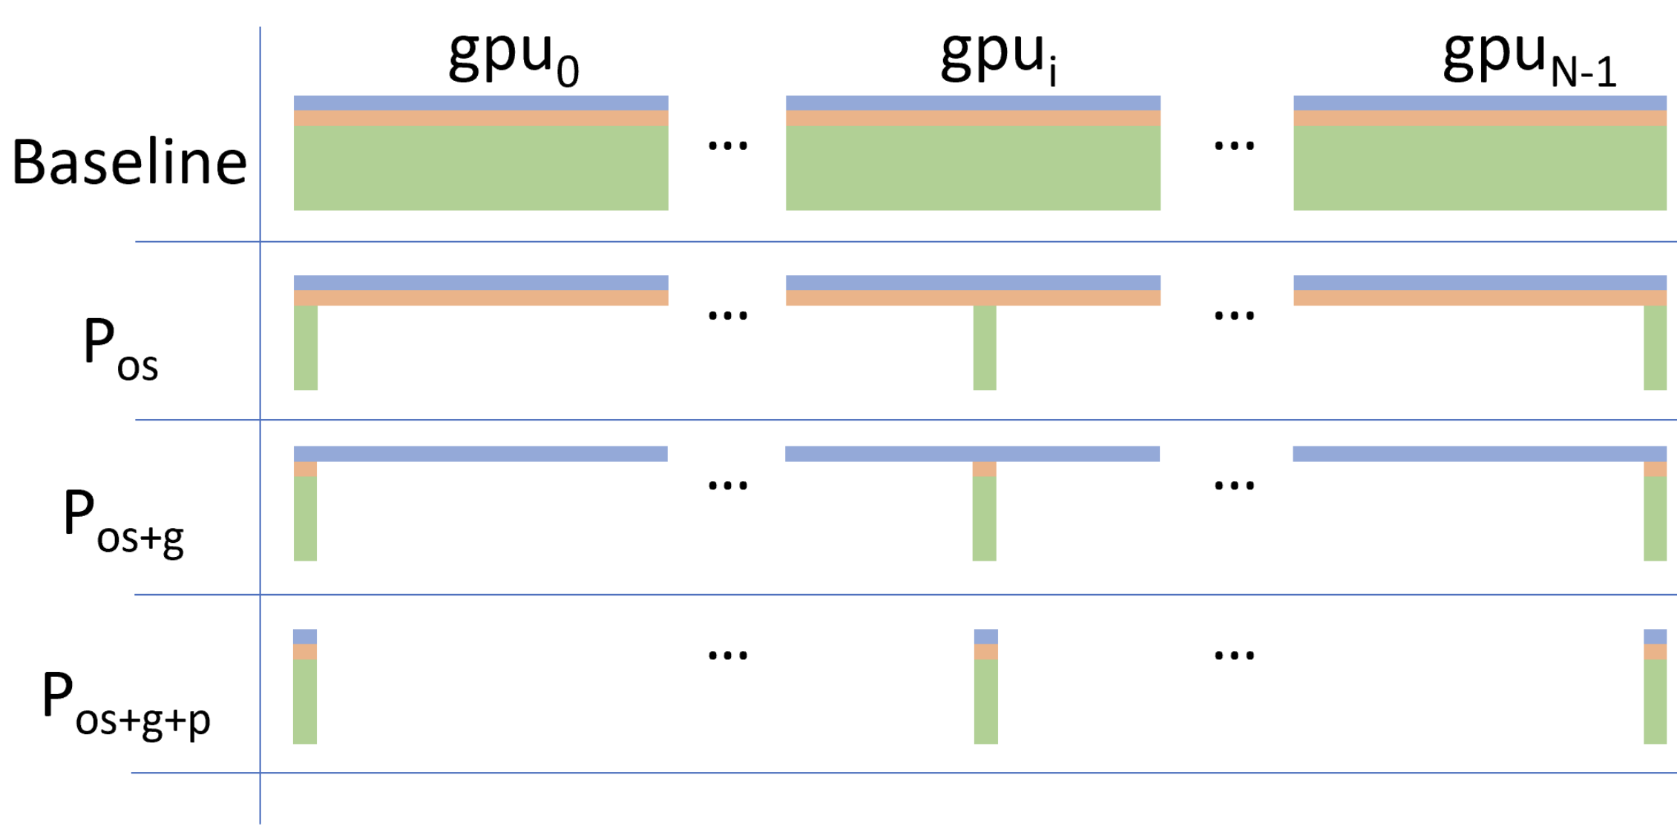

Offloading with DeepSpeed + ZeRO
Stage 1: Optimizer states are partitioned ($P_{os})$
Stage 2: Gradients also partitioned ($P_{os+g})$
Stage 3: Also partition model params ($P_{os+g+p})$
Figure: “ZeRO: Memory Optimizations Toward Training
Trillion Parameter Models” by Rajbhandari, et al. 2020
Notes:
From https://www.deepspeed.ai/tutorials/zero/:
Stage 1: The optimizer states (e.g., for Adam optimizer, 32-bit weights, and the first, and second moment estimates) are partitioned across the processes, so that each process updates only its partition.
Stage 2: The reduced 16-bit gradients for updating the model weights are also partitioned such that each process retains only the gradients corresponding to its portion of the optimizer states.
Stage 3: The 16-bit model parameters are partitioned across the processes. ZeRO-3 will automatically collect and partition them during the forward and backward passes.
Or ZeRO++ adds other features: https://www.deepspeed.ai/tutorials/zeropp/

Slide 17
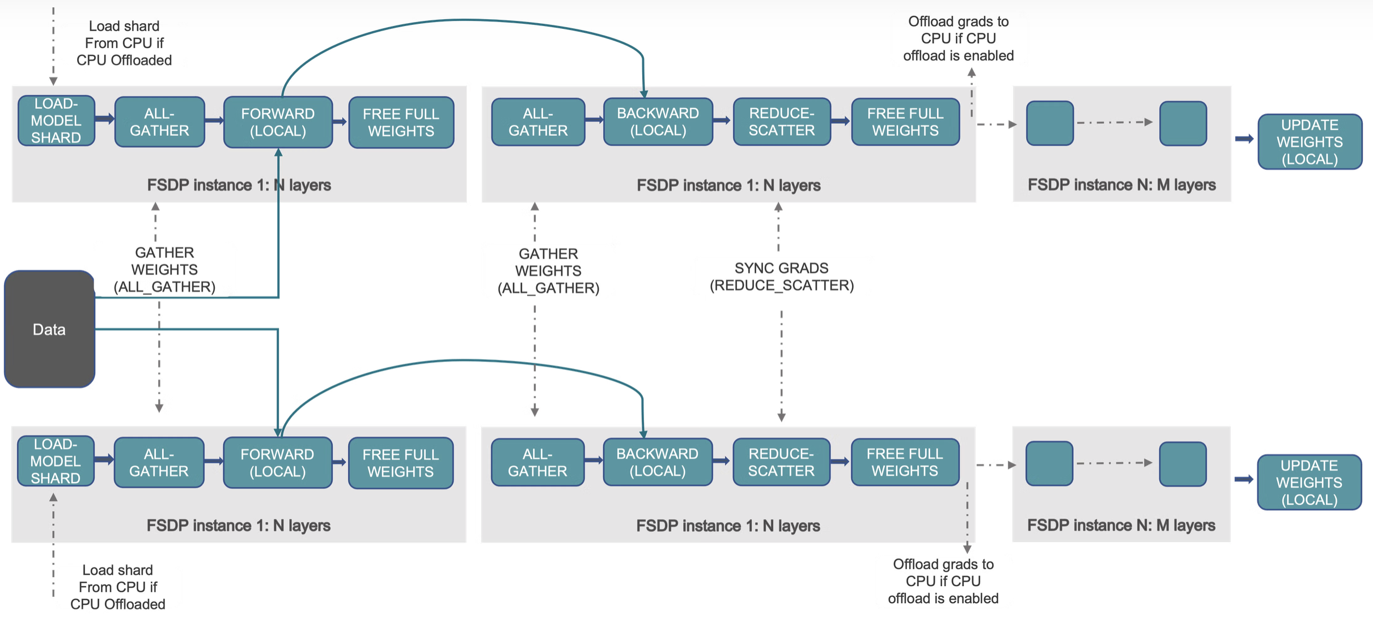
PyTorch Fully Sharded Data Parallel (FSDP)
Similar to ZeRO: data parallel training + sharding model’s parameters, gradients and optimizer states
(Optionally: offload model parameters to CPUs)
Figure: PyTorch Blog
Notes:
https://pytorch.org/blog/introducing-pytorch-fully-sharded-data-parallel-api/

Slide 18
Model Parallelism Overview
Splits a model’s parameters or ops across devices to handle very large networks
Tensor parallelism: shard weight tensors within each layer; all devices work on same batch
Pipeline parallelism: cut the model into sequential stages; devices process different micro-batches in flight

Slide 19
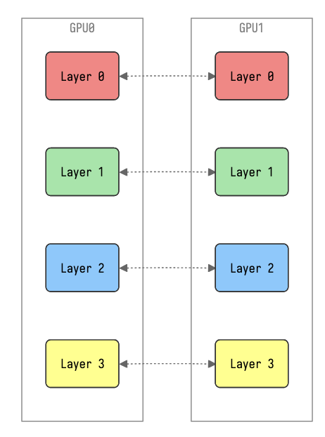
Tensor Parallelism
Each tensor is split up into multiple chunks
Each shard of the tensor resides on its designated GPU
During processing each shard gets processed separately (and in parallel) on different GPUs
  Synced at end of the step
  Similar to distributed GEMMs
Good for: model can’t fit on single device
But: complicated to implement. Ideally only within a node
More details: Hugging Face Tutorial
Figure: Sam Foreman

Slide 20
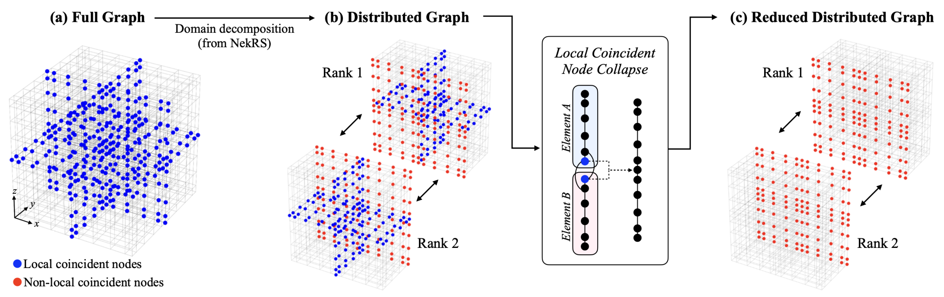
Spatial Parallelism for Graphs (example)
Once we have a distributed graph, we can put sub-graphs on GPUs.
In mesh-based context, this resembles spatial parallelism.
Not done – need to enforce physical consistency across sub-graphs!
Barwey et al., 2024, Scalable and consistent graph neural networks for distributed mesh-based data-driven modeling. SC24-W, IEEE.

Slide 21
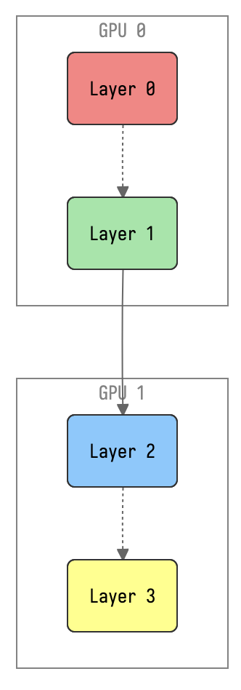
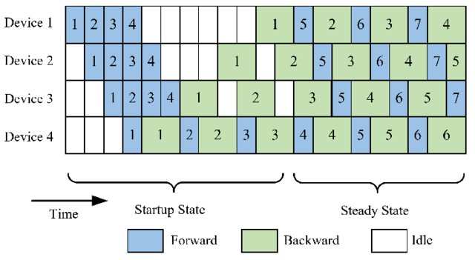
Pipeline Parallelism
Model is split up vertically (layer-level) across multiple GPUs
Each GPU:
  has a portion of the full model
  processes in parallel different stages of the pipeline (on a small chunk of the batch)
Challenge: scheduling and “pipeline bubbles”
Figure: Sam Foreman
More details: Hugging Face Tutorial
Figure: “Dive into Big Model Training” by Liu & Jiang (2022)

Slide 22
Compare Tensor & Pipeline Parallelism
Aspect | Tensor Parallelism | Pipeline Parallelism
Granularity | Per-layer shards; sync every op | Only at stage boundaries
Concurrency | All devices on same batch | Different micro-batches on each stage
Overhead | Fine-grained all-reduces | Startup/drain bubbles
Best for | Huge layers, heavy tensor ops | Deep models, balanced stage compute
Table by Nathan Nichols

Slide 23
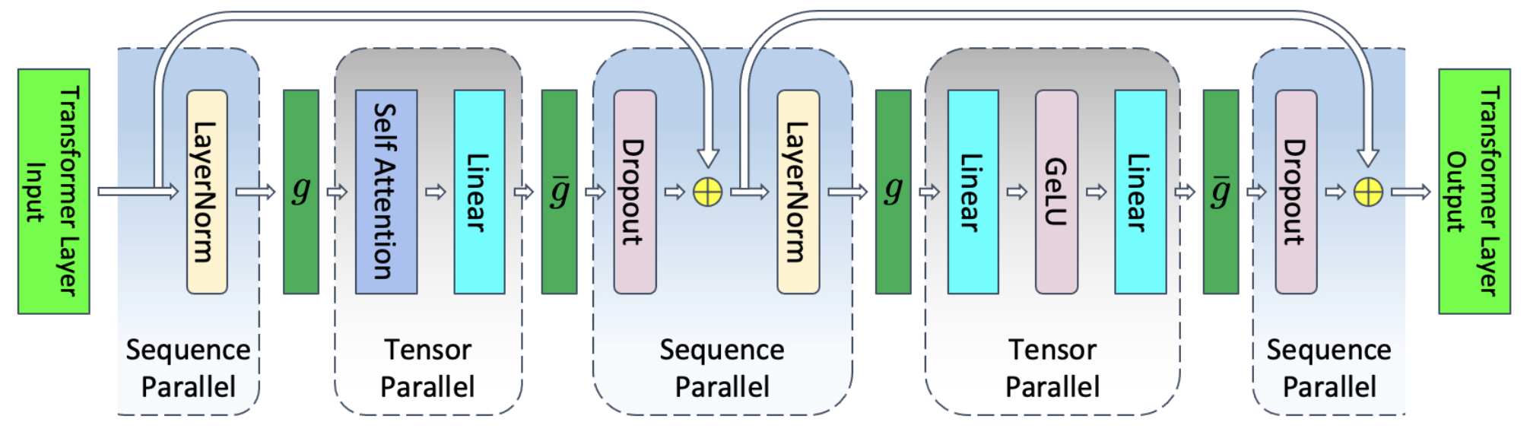
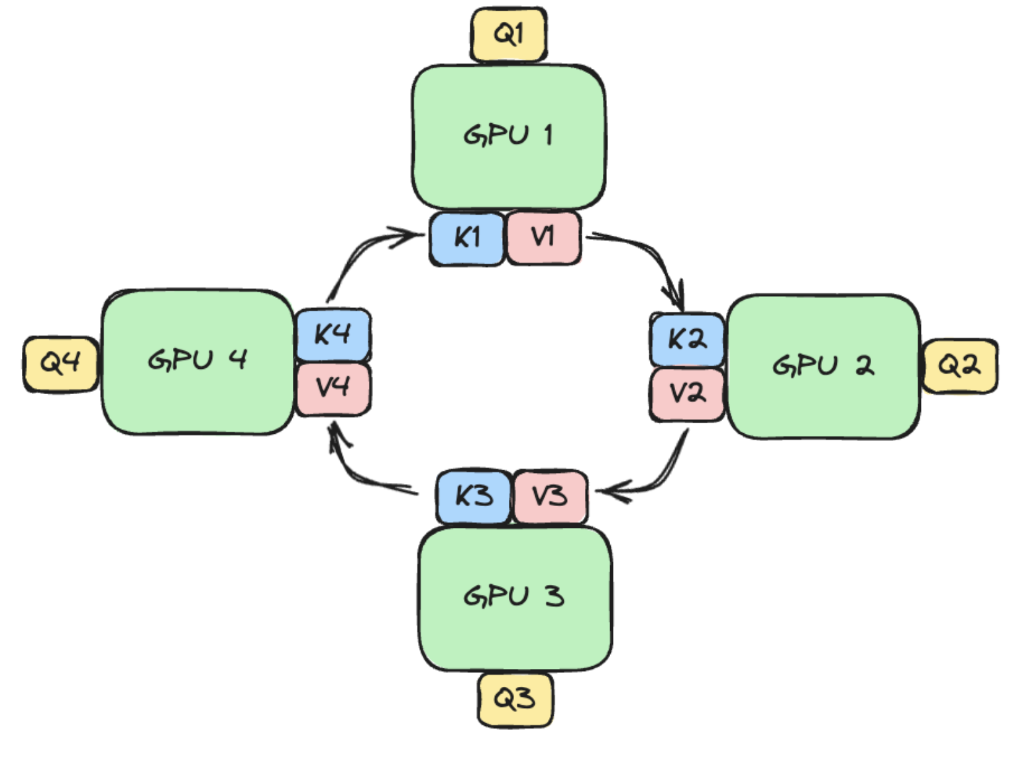
Sequence/Context/Expert Parallelism
Model architecture and application-specific forms of parallelism
Sequence parallelism (SP):
An extension of tensor parallelism (typically for LLMs), where the input sequence is scattered and gathered for specific operations
Context parallelism:
Like SP but shards the sequence across all layers, including the attention, implemented with ring attention
Expert parallelism:
Specific for Mixture of Experts (MoE) models, where different “experts” are placed on different GPUs
https://arxiv.org/pdf/2205.05198
Ring Attention (Coconut Mode blog)
Slide by Väinö Hatanpää

Slide 24
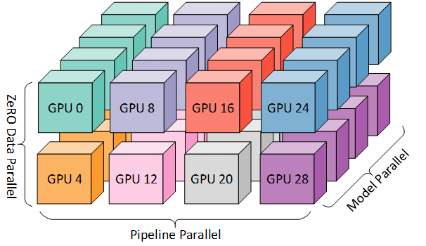
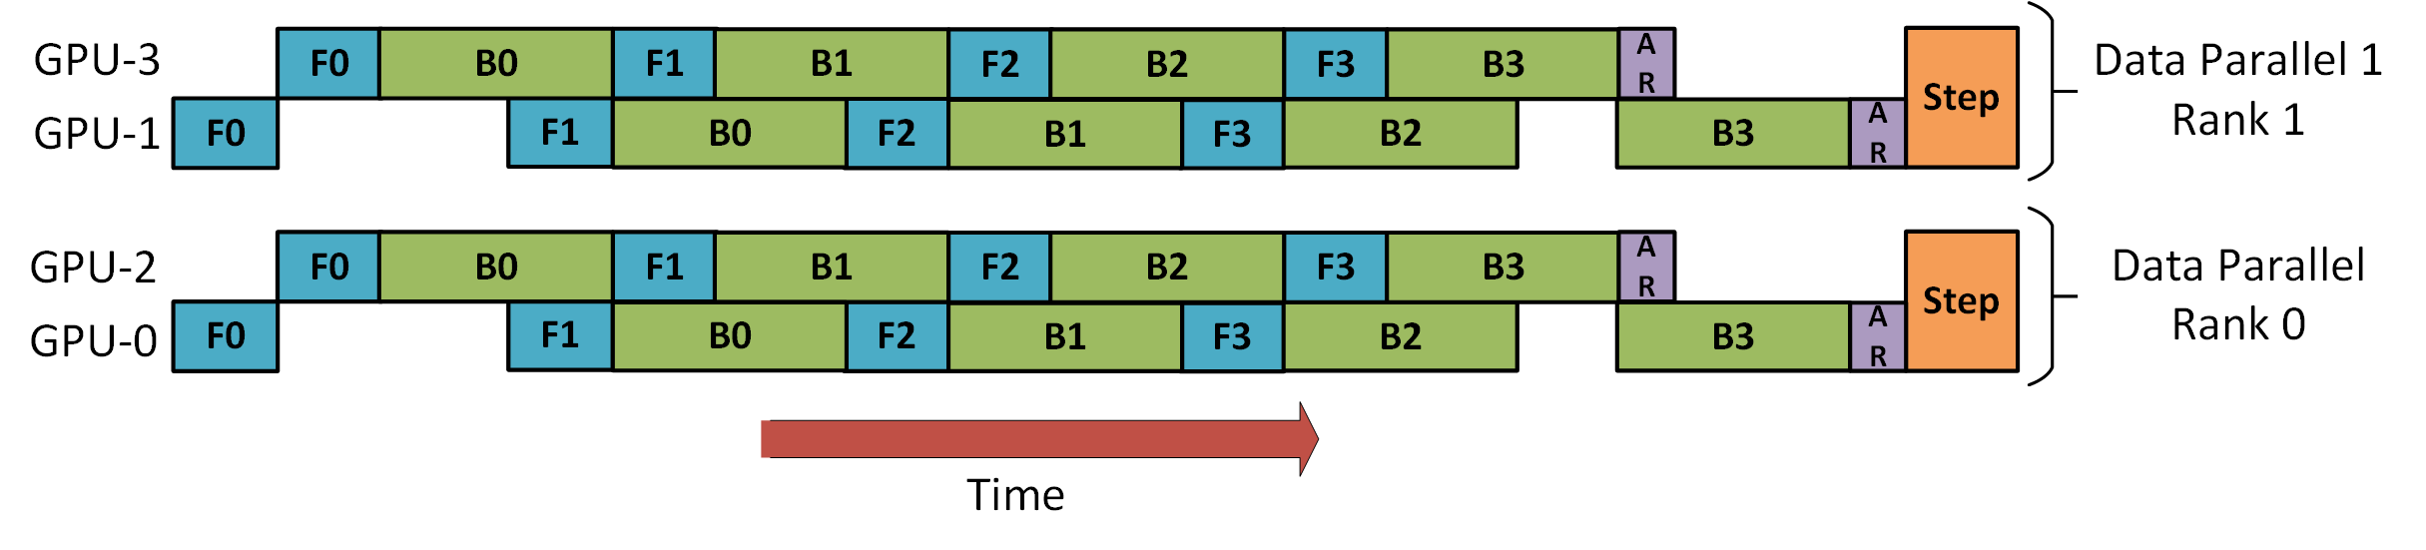
2D/3D Parallelism
Credit: DeepSpeed pipeline tutorial
Credit: “DeepSpeed: Extreme-scale model training for everyone” blog post

Slide 25
Choosing a Strategy
Considerations:
How many GPUs are available
How large is the model
How fast is the network connectivity between the GPUs in a node or between nodes
What kind of implementations are available
For example:
Simple model, fits into a single GPU -> DP
Large LLM -> A lot of GPUs and parallelism required
Slide by Väinö Hatanpää
Notes:
For more: https://samforeman.me/talks/ai-for-science-2024/#deciding-on-a-parallelism-strategy

Slide 26
Hands On, Part 2
https://github.com/argonne-lcf/ATPESC_MachineLearning

