Slide 1
Agentic Workflows for Science
Thang D. Pham, Murat Keçeli
Computational Science (CPS) Division, Argonne National Laboratory

Slide 2
From LLMs to agentic AI
Large language models (LLMs):
User prompt
LLMs
Output
Agentic AI:
User prompt
LLMs
Output
Tools

Slide 3
Science may require more than just reasoning
Reasoning-centered agent workflow
Scientific discovery workflow
Existing knowledge
Existing knowledge
Generate (Update) hypotheses
Generate hypotheses
Design experiments
LLM evaluations
critique • debate • rank • select
Execute experiments
Analyze results

Slide 4
How agentic AI fits in scientific workflows?
Scientific discovery workflow
Existing knowledge
Generate (Update) hypotheses
Agentic AI
Design experiments
Execute experiments
Analyze results

Slide 5
Agent harness vs. custom agentic workflow:
Who manages the loop?
Using agent harness (Claude Code, Codex, etc.)
Building agentic workflow (LangGraph, SmolAgent, etc.)
Provide context and instructions
Define workflow state
Give the agent a task
Define agents, tools and functions
Harness plans, acts and iterates
Specify routing, validation, and recovery
Review and refine the results
Run, inspect, and improve the workflow
The harness controls the execution trajectory
The developer controls the execution trajectory

Slide 6
Choosing between agent harness vs. custom agentic workflow
Using agent harness (Claude Code, Codex, etc.)
Fast to start; well for interactive tasks
Built-in agent loop, tool use, context management
General-purpose file, shell, web, and coding tools
Less infrastructure to build and maintain
Less control
Building agentic workflow (LangGraph, SmolAgent, etc.)
Requires upfront design and configuration
Explicit control over state, routing, tools, and agent loops
Integrate domain-specific scientific tools
Custom validation, recovery, and stopping criteria
More control, reproducible and auditable execution
An agent harness provides autonomy quickly; a custom agentic workflow provides greater control, specialization, and reproducibility.

Slide 7

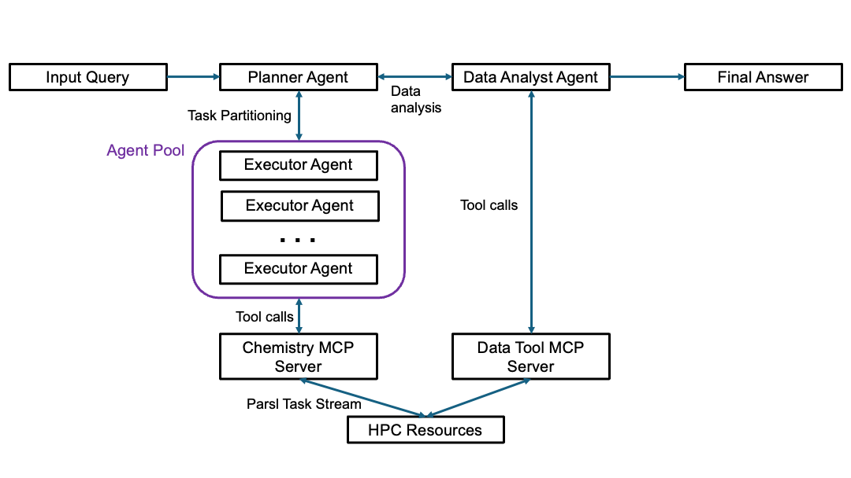
ChemGraph:
Agentic AI for Autonomous
Scientific Workflows
HPC Orchestration:
  Natural language to scalable execution
  Planner-Executor agents with MCP + Parsl
  Demonstrated on Aurora for high-through campaigns
Current science enabled
  High-throughput material screening
  Multi-objective property evaluation
  Automated computational chemistry workflows
Open and modular
  Supports diverse simulation backends.
  Invites users to bring their own tools to ALCF for agentic automation.
  Already enabling collaborations in porous materials, spectroscopy, and electrochemistry.
Pham, T. D., Tanikanti, A., & Keçeli, M. Communications Chemistry 9, 33 (2026). https://doi.org/10.1038/s42004-025-01776-9.
Pham, T. D., Tummalapalli, H., Bhuiyan, F. H., Vázquez Mayagoitia, Á., Simpson, C., Balin, R., Vishwanath, V., & Keçeli, M. (2026). https://arxiv.org/abs/2604.07681v1.
ChemGraph enables scientists to bring their tools to ALCF and turn research questions into scalable, AI-orchestrated discovery workflows.
GitHub Repository: https://github.com/argonne-lcf/ChemGraph

Slide 8
Guardrails: Runtime controls for
agentic workflows
Guardrails constrain, validate, or interrupt agent behavior during execution
  Block unsafe or unauthorized tool use
  Detect prompt injection or untrusted instructions
  Prevent invalid actions from propagating through the workflow
Guardrails can be implemented at different levels
  Deterministic middleware and validation functions
  Tool permissions, sandboxing, and resource limits
  Human approval for high-impact decisions

Slide 9
Evaluating agentic workflows
Why evaluate?
  Agentic workflows are stochastic and may fail at multiple stages
  A correct final answer can still come from an incorrect or inefficient trajectory
What to evaluate?
  Outcome: scientific answer, prediction, or generated result
  Trajectory: reasoning steps, tool selection, inputs, and intermediate outputs
  System behavior: reliability, recovery, efficiency, cost, and reproducibility
How to evaluate?
  Match the metric to the output type: exact match, numerical tolerance, schema checks
  Compare against programmatic ground truth, expert-created answers, experimental data
  Repeat runs and report success rates, variability, and common failure modes

Slide 10
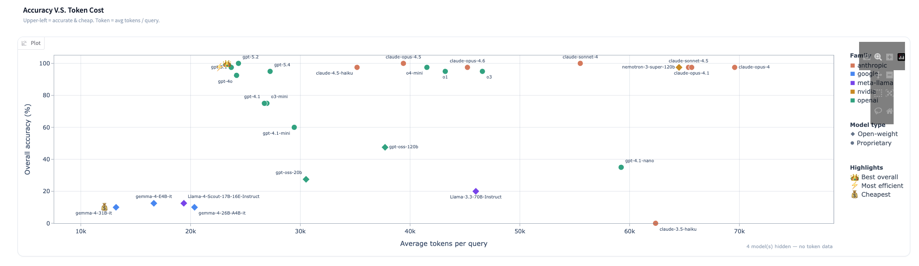
Evaluating agentic workflows
ChemGraph leaderboard: https://huggingface.co/spaces/Autonomous-Scientific-Agents/chemgraph-leaderboard

Slide 11
Building agentic workflow: A hands-on example
Overall
What we will use in the examples
LLMs
ALCF Inference service
Orchestration, state & control
LangGraph
Tool interfaces & adapter
LangGraph tool & MCP
Execution and data services
Parsl
Scientific software
MACE

Slide 12
LangGraph
LangGraph is a framework for defining agentic workflows as a graph of steps
Each node can represent an LLM call, tool call, validation step, or human review
Maintains workflow state across steps
Supports branching, retries, loops, checkpointing, and interrupts
Useful when scientific agents need durable execution and human-in-the-loop control
Reference: https://github.com/langchain-ai/langgraph

Slide 13
Model Context Protocol (MCP)
Standard interface for exposing external tools to agents
Separates the agent from the tool implementation
Tools can run in different environments from the agent
Enables reusable scientific services: simulation, analysis, databases, HPC submission
Reference: https://modelcontextprotocol.io/docs/2026-07-28/getting-started/intro

Slide 14
Hands-on example
Instructions available at https://github.com/argonne-lcf/ATPESC_MachineLearning/tree/master/13_agentic_workflows_for_science/README.md
Get an interactive job on Aurora with 1 or 2 nodes:
qsub -I -A ATPESC2025 -q ATPESC -l select=1 -l walltime=0:60:0 -l filesystems=home:flare
Activate the environment:
module load frameworks
source activate.sh
Authenticate with ALCF inference service:
python scripts/inference_auth_token.py authenticate
source scripts/get_alcf_token.sh

Slide 15
Example 1: Build a ReAct agent with LangGraph
Prompt= (
f"Use the energy tool to calculate {structure}. "
f"Use model={args.mace_model}, device={args.device}, "
f"and backend={args.backend}. Report the energy in eV and identify which backend produced it."
Human prompt
START
ALCF Inference Service
LLM
Tools
(LangGraph tool)
END
python examples/01_langgraph_mace.py \
--structure data/structures/water.xyz \
--mace-model small \
--device cpu \
--backend mace

Slide 16
Example 2: Build agent with MCP tools
Terminal 1:
python examples/02_mcp_server.py --host 127.0.0.1 --port 8000
Terminal 2:
export NO_PROXY=127.0.0.1,localhost,::1
export no_proxy=127.0.0.1,localhost,::1
python examples/02_mcp_agent.py \
--server-url http://127.0.0.1:8000/mcp \
--structure data/structures/water.xyz \
--backend mace \
--device xpu
Human prompt
START
ALCF Inference Service
LLM
Tools
(MCP tools)
END
Terminal 2
Terminal 1

Slide 17
Example 3: Build agent with ensemble tools
Terminal 1 (with "$PBS_NODEFILE”)
export ATPESC_WORKER_INIT="source /lus/flare/projects/ATPESC2026/EXAMPLES/track-6-agentic-workflows-for-science/ATPESC_MachineLearning/13_agentic_workflows_for_science/activate.sh; export TMPDIR=/tmp"
python examples/03_ensemble_server.py --port 8001
Terminal 2:
export NO_PROXY=127.0.0.1,localhost,::1
export no_proxy=127.0.0.1,localhost,::1
python examples/03_ensemble_agent.py \
--server-url http://127.0.0.1:8001/mcp \
--device xpu \
--backend mace \
data/structures/*.xyz
# or data/generated_structures
Human prompt
START
ALCF Inference Service
LLM
Tools
(MCP tools)
END
Execution
(Parsl)
Terminal 2
Terminal 1 (Needs $PBS_NODEFILE)

Slide 18
Example 4: Build agent with human-in-the-loop
python examples/04_human_in_the_loop.py \
--structure data/structures/water.xyz \
--backend emt \
--checkpoint-db runs/hitl.sqlite \
--thread-id demo-water
python examples/04_human_in_the_loop.py \
--structure data/structures/water.xyz \
--backend emt \
--thread-id restart-demo \
--leave-pending
python examples/04_human_in_the_loop.py \
--checkpoint-db runs/hitl.sqlite \
--thread-id restart-demo \
--resume approved
Human prompt
START
ALCF Inference Service
LLM
Tools
Human’s input
END

Slide 19
Conclusions
Agentic AI moves beyond single prompts by combining reasoning, tools, state, and iterative action.
Topics covered:
  Harness vs customized workflow
  Guardrails
  Evaluation
  Examples with LangGraph, MCP, Parsl and ALCF inference service
The goal is not to replace scientific judgment, but to build systems that automate and make scientific workflows more scalable, transparent, and reproducible.

Slide 20
Acknowledgements
This research used resources of the Argonne Leadership Computing Facility, a U.S. Department of Energy (DOE) Office of Science user facility at Argonne National Laboratory. This work was supported by the Office of Science, U.S. Department of Energy, under Contract No. DE-AC02-06CH11357.

Slide 21
Thank you for your attention!

